Slide 1
Chapter : Processes

Slide 2
Chapter : Processes
Process Concept
Process Scheduling
Operations on Processes

Slide 3
Process
Program: Passive entity
Process is instance of a program under executing
Process – a program in execution
Active Entity b/c it has Program Counter associated to it.
Process execution must progress in sequential manner
A process includes:
program counter
stack
data section

Slide 4
Process
A process has text section/ code section.
It also includes the current activity, as represented by:
Value of the program counter
the contents of the processor’s registers.
A process may also include a heap,
Memory that is dynamically allocated during process run time.

Slide 5
Process
A process also includes the process stack, which contains:
temporary data:
function parameters,
return addresses,
local variables
data section, which contains global variables.

Slide 6
Process
A program is a passive entity,
such as a file containing a list of instructions stored on disk.
A process is an active entity with a program counter specifying the next instruction to execute and a set of associated resources.

Slide 7
Process States
As a process executes, it changes state
new: The process is being created
ready: The process is waiting to be assigned to a processor and is ready to get executed
running: Instructions are being executed
waiting: The process is waiting for some event to occur/ waiting for resources
terminated: The process has finished execution

Slide 8
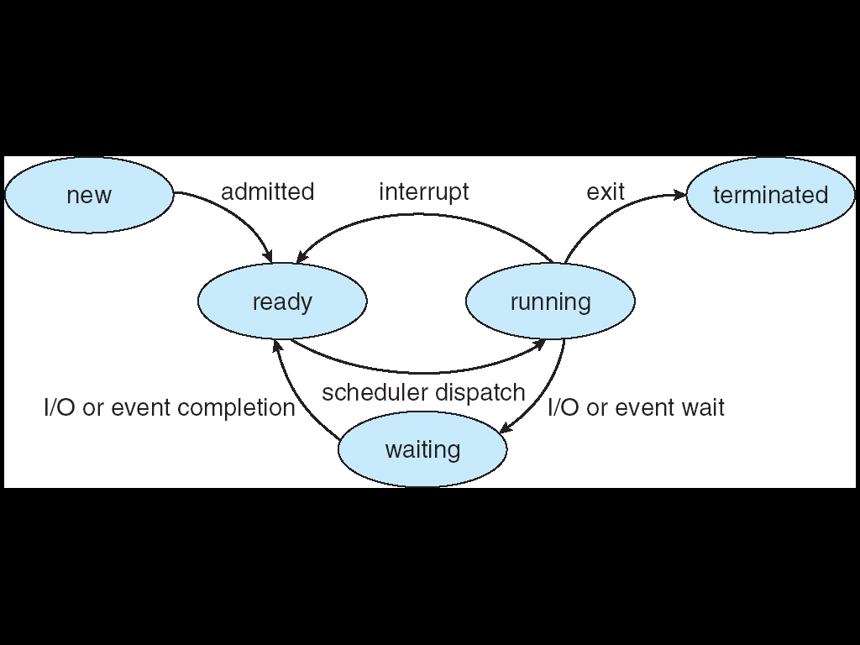
Process States

Slide 10
Process Control Block (PCB)
A data structure in the operating system kernel containing the information needed to manage a particular process.
The PCB is "the manifestation of a process in an operating system".

Slide 11
Process Control Block (PCB)
Information associated with each process:
1. Process State- new, ready….etc.
2. Pointer- to the parent process
3. Program Counter- next instruction to be executed.
4. Process Number- Unique identification number in OS
5. CPU Registers- Various CPU registers where process need to be stored for execution for running state.
6. CPU Scheduling Information- Process Priority and other info. required for scheduling

Slide 12
Process Control Block (PCB)
7. Memory-Management Information- Registers, Page tables (where process is saved)used by OS
8. Accounting Information- For how long CPU and other resources are allocated to process
9. I/O Status Information- List of devices allocated to the process

Slide 13
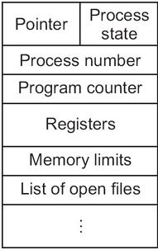
Process Control Block (PCB)

Slide 14
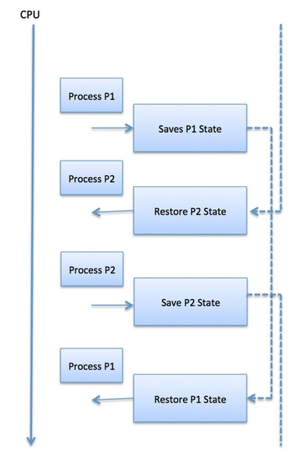
Context Switch
When CPU switches to another process, the system must save the state of the old process in the stack and load the saved state for the new process or reload the state of current process from stack.

Slide 15
Context Switch
Switching the CPU to another process requires:
saving the state of the old process
loading the saved state for the new process.
This task is known as a context switch.

Slide 16
Context Switch
The context of a process is represented in the Process Control Block(PCB) of a process;
When a context switch occurs:
The Kernel saves the context of the old process in its PCB and
Loads the saved context of the new process scheduled to run.

Slide 17
Context Switch
Context switch time is pure overhead, because the system does no useful work while switching.
Its speed varies from machine to machine depending on:
Memory speed
Number of registers that must be copied
Existence of special instructions(such as a single instruction to load or store all registers).
Typical speeds range from 1 to 1000 microseconds.

Slide 18
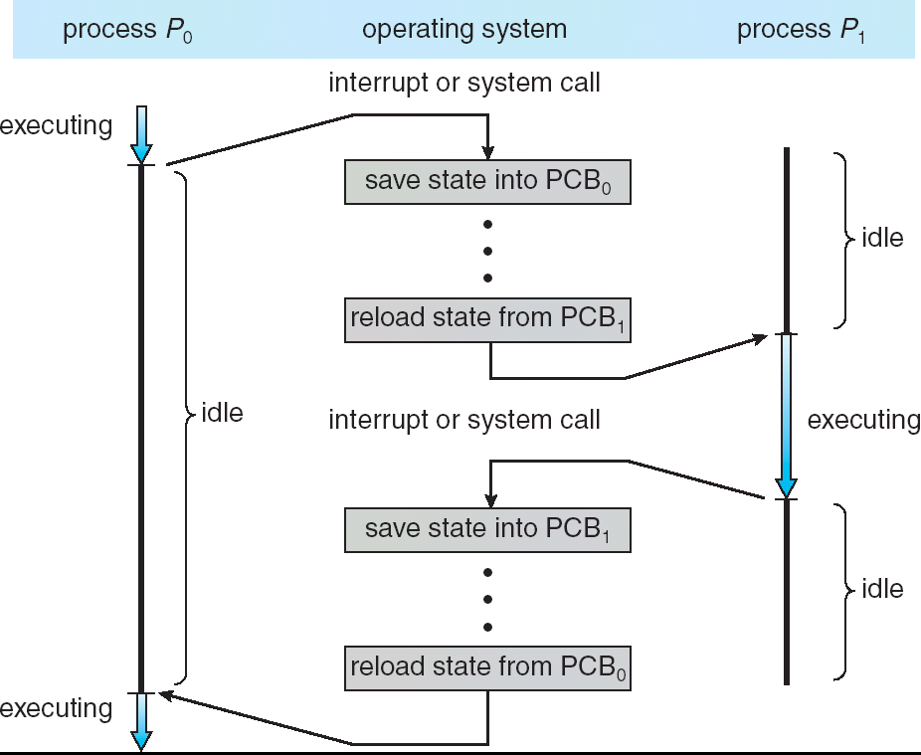
CPU Switch From Process to Process

Slide 19
Scheduling Queues
The OS maintains all PCBs in Process Scheduling Queues.
The OS maintains a separate queue for each of the process states and PCBs of all processes in the same execution state are placed in the same queue.
When the state of a process is changed, its PCB is unlinked from its current queue and moved to its new state queue.

Slide 20
Scheduling Queues
Schedulers fall into one of two general categories:
Non-pre-emptive scheduling: When the currently executing process gives up the CPU voluntarily. Or releases the CPU when it is completely executed.
Pre-emptive scheduling: When the operating system decides to favor another process, pre-empting the resource (CPU) from the currently executing process.

Slide 21
Process Scheduling Queues
Job queue − This queue keeps all the processes in the system.
Ready queue − This queue keeps a set of all processes residing in main memory, ready and waiting to execute.
A new process is always put in this queue.
Device queues − The processes which are blocked due to unavailability of an I/O device constitute this queue.

Slide 22
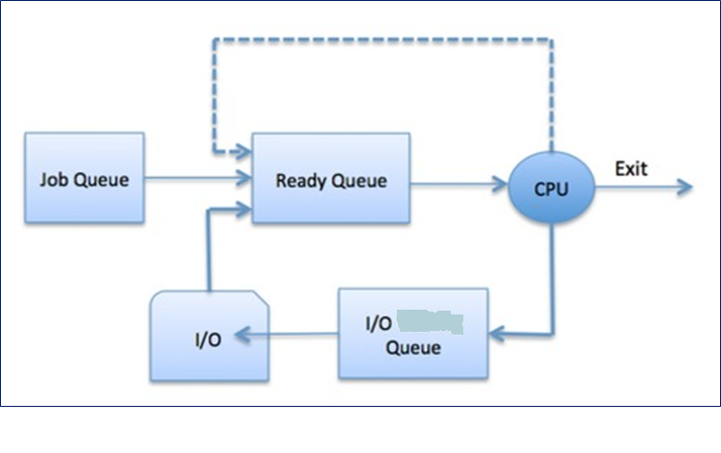
Process Scheduling Queues

Slide 23
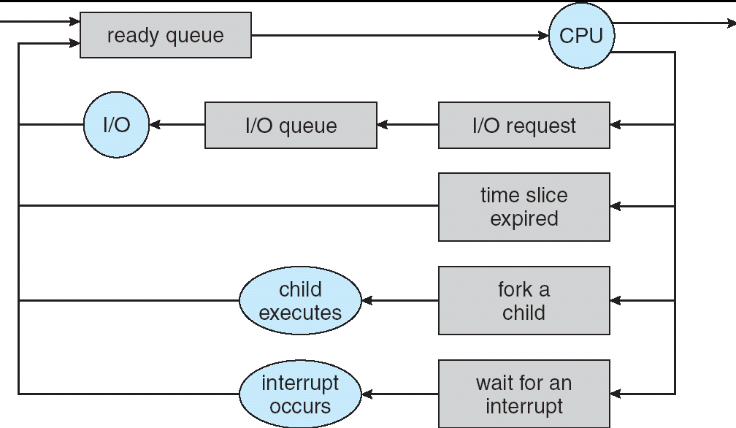
Representation of Process Scheduling
Queuing Diagram

Slide 24
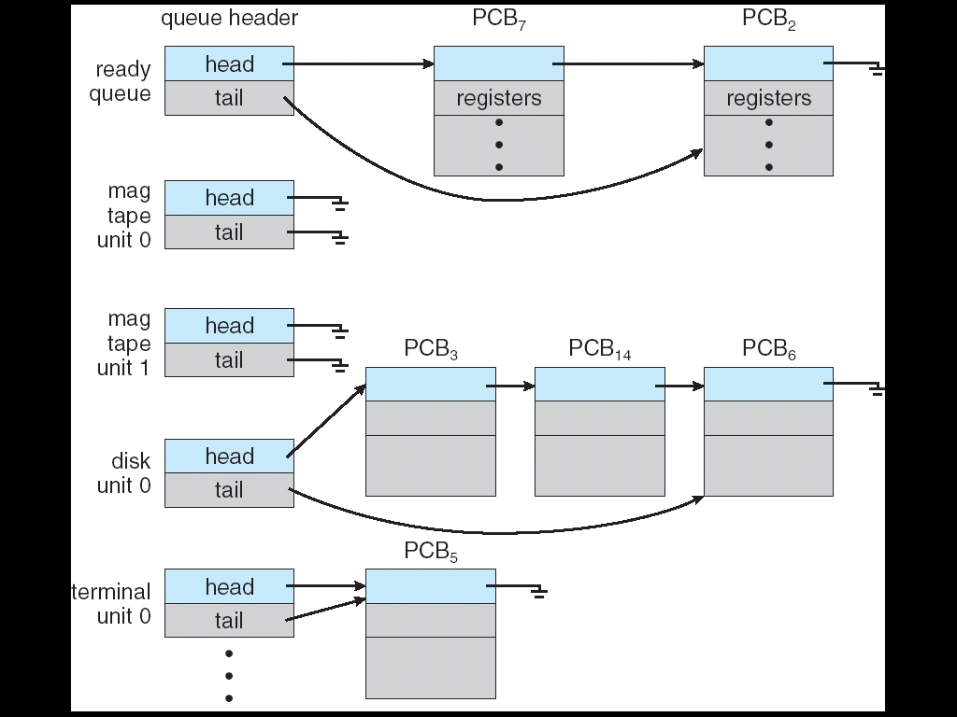
Ready Queue And Various I/O Device Queues
Ready Queue is implemented using Linked List

Slide 25
Operations on Process
1. Process Creation
2. Process Termination

Slide 26
Process Creation
Parent process creates children processes, using fork() which in turn create other processes, forming a tree of processes.
The process that creates other processes is termed the parent process
Newly created process is termed as child process

Slide 27
Process Creation (Cont.)
Resource sharing
Parent and children share all resources
Children share subset of parent’s resources
Parent and child share no resources
Execution Sequence
Parent and children execute concurrently
Parent waits until children terminate

Slide 28
Process Creation (Cont.)
Address Space
Address space may refer to a range of either physical or virtual addresses accessible to a processor or reserved for a process.
Child process is duplicate of the parent process (same program and data
Child process has a new program loaded into it

Slide 29
Process Creation (Cont.)
Each process is identified by its process identifier
UNIX examples
fork () system call creates new process
exec() system call used after a fork to replace the process’ memory space with a new program

Slide 30
fork()
System call fork() is used to create processes.
It takes no arguments and returns a process ID.
The purpose of fork() is to create a new process, which becomes the child process of the caller.
After a new child process is created, both processes will execute the next instruction following the fork() system call.

Slide 31
This can be done by testing the returned value of fork():
If fork() returns a negative value, the creation of a child process was unsuccessful.
fork() returns a zero to the newly created child process.
fork() returns a positive value, the process ID of the child process, to the parent.

Slide 32
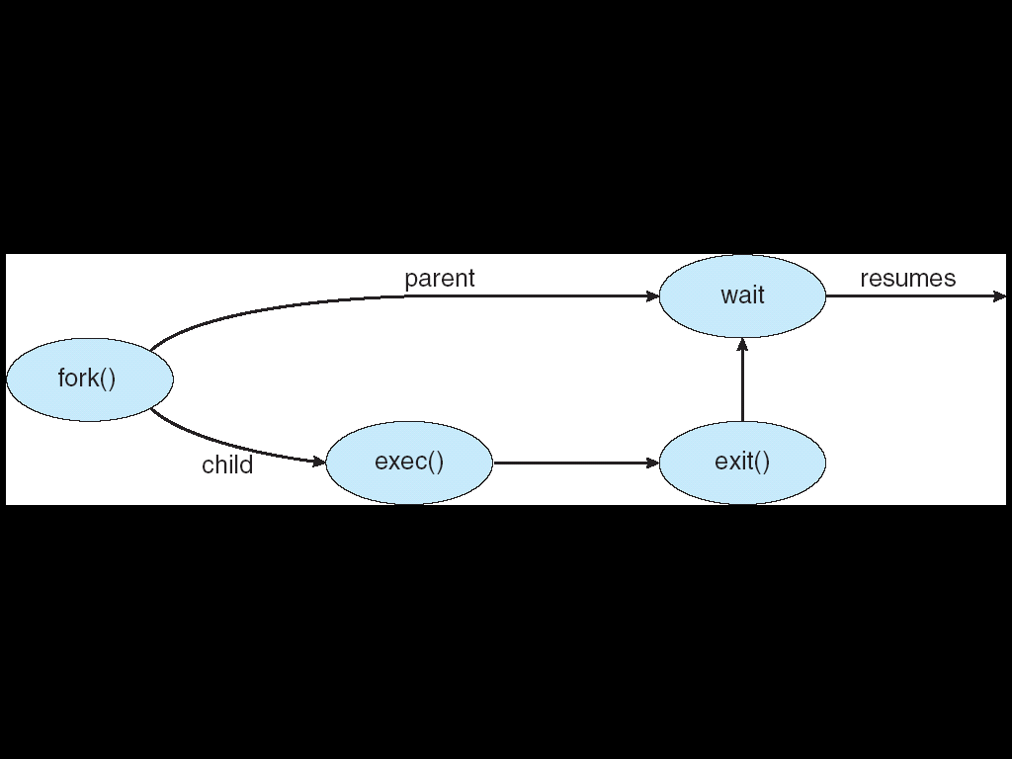

Slide 33
Process Creation
There are two options for the parent process after creating the child :
Wait for the child process to terminate before proceeding.
Run concurrently with the child, continuing to process without waiting.

Slide 34
Process Termination
Process executes last statement and asks the operating system to terminate it (by using exit() system call)
Output the data from child to parent (via wait)
Process resources are de-allocated by the operating system

Slide 35
Process Termination
Parent may terminate execution of children processes (abort)
Why?
Child has exceeded allocated resources
Task assigned to a child is no longer required
If a parent is exiting/Terminated
Some operating systems do not allow the child to continue if its parent terminates
All children terminated - cascading termination

